Slide 1
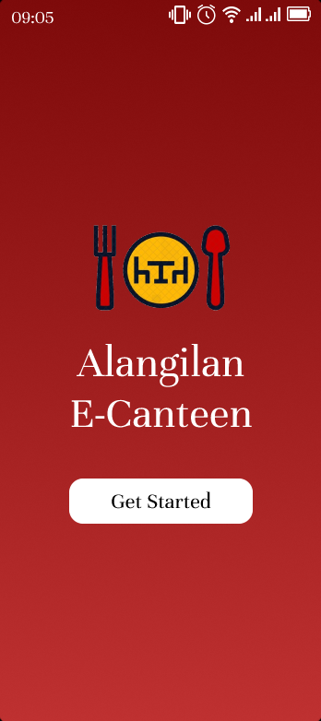
Home
Problem
Solution
Product
Target
Team
Alangilan
E-Canteen
YOUR DIGITAL CAMPUS DINING DESTINATION!

Slide 2
Home
Problem
Solution
Product
Target
Team
Problem
Crowded
Long line Queue
Busy Schedule

Slide 3
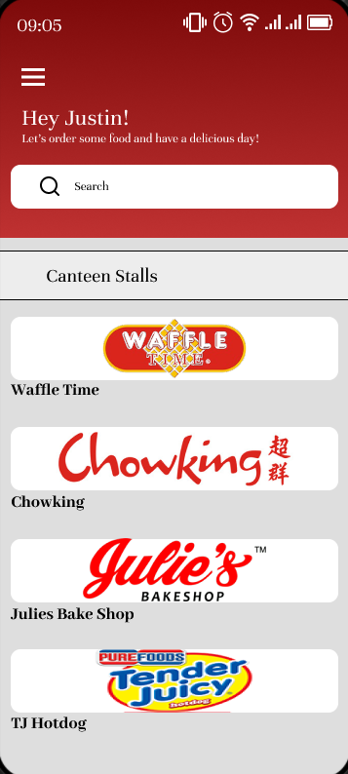
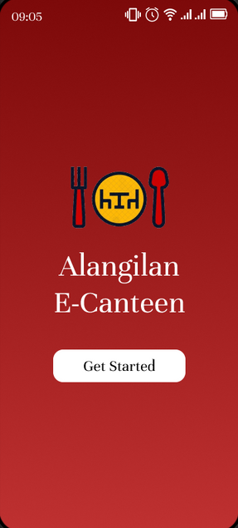
Home
Problem
Solution
Product
Target
Team
Solution
Develop a "BSU-Alangilan E-Canteen", a comprehensive web application for campus canteen to enhance the food ordering process for students
The web application offers a user-friendly interface for both canteen salespersons and students.

Slide 4
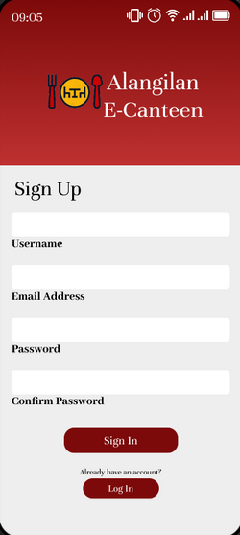
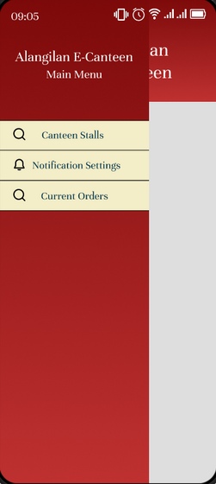
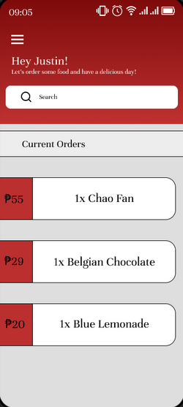
Home
Problem
Solution
Product
Target
Team
Product
The interface would allow them to add, edit, or remove items from the menu, along with corresponding prices. Students should have the ability to select items from the menu and add them to their order. Also, the students are able to see if their orders are ready and ready for pick-up.

Slide 5
Home
Problem
Solution
Product
Target
Team
Target
Sustainable Development
GOOD HEALTH AND WELL-BEING
REDUCED INEQUALITIES
ZERO HUNGER
access to food in canteen and purchase anytime and anywhere
all student, faculty, and staff have acces to the web application no matter the gender, race, religion, and ethnicity.
Through tap on mobile devices, all have access to purchase food every time they feel hungry and replenish their energy.
lessen meal skipping due crowded facility and lack of time

Slide 6



Home
Problem
Solution
Product
Target
Team
First hand experience
Why
us?
2. teamwork
3. Passion and Dedication

Slide 7
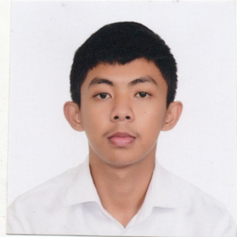



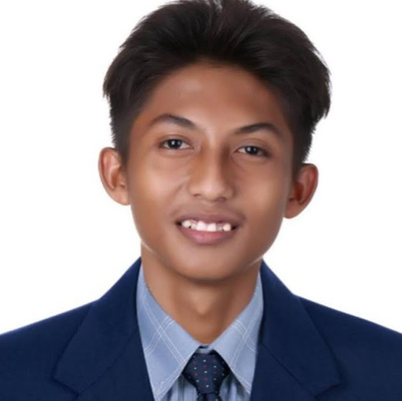
Home
Problem
Solution
Product
Target
Team
Team 8
Magcawas, Arish Jay
CIO
Vasquez, Jilbert S.
CEO
Vinluan, John Michael
CFO
Reyes, Beaver Jeddan B.
CMO
Tolentino, Justin Cyrus
CTO

